Slide 1
Digital Portfolio
STUDENT NAME: SHAMKUMAR V
REGISTER NO AND NMID: 67F40BE3E9D252D91514472E833F6EE3
DEPARTMENT: B.Sc,Computer Science
COLLEGE: Shanmuga Industries Arts & Science college
UNIVERSITY: Thiruvalluvar University

Slide 2
PROJECT TITLE: Personal Portfolio Website for Showcasing Skills and Projects

Slide 3


AGENDA
Problem Statement
Project Overview
End Users
Tools and Technologies
Portfolio design and Layout
Features and Functionality
Results and Screenshots
Conclusion
Github Link
3/21/2024 Annual Review

Slide 4

PROBLEM STATEMENT
In the digital world, students and young professionals often face difficulties in presenting their skills and learning journey in an attractive way. A simple resume cannot always show creativity, coding knowledge, or project progress. Without a portfolio, it becomes harder for employers, teachers, or peers to understand the true capability of a student. Therefore, there is a need for a personal portfolio website that not only introduces the individual but also highlights their skills, projects, and progress in a clear and interactive manner.

Slide 5

PROJECT OVERVIEW
This project is a personal portfolio website made for Shamkumar. The website has different sections such as Home, About, Services, Projects, and Contact. It is designed using HTML, CSS, and JavaScript to make it modern and responsive. The main purpose of the project is to show personal details, skills, and week-by-week learning projects. The Projects section is special because it links to live demos of the work.

Slide 6

WHO ARE THE END USERS?
The portfolio website can be used by different groups of people. First, it is useful for students, as it acts as a learning model to build their own portfolio. Secondly, employers and recruiters can quickly check the candidate’s work before offering jobs or internships. Teachers and peers can also review the portfolio to track weekly progress and assignments.

Slide 7

TOOLS AND TECHNIQUES
The portfolio website is built using HTML5, CSS3, and JavaScript, which are the most common and powerful web technologies. HTML5 provides the structure of the web pages, while CSS3 is used to add style, colors, animations, and responsive layouts. JavaScript adds interactivity like menu toggling, dark mode, and validation for forms. For icons, the project uses Boxicons, and for showcasing projects, external CodePen links are embedded.

Slide 8
POTFOLIO DESIGN AND LAYOUT
The design of the portfolio is clean, modern, and user-friendly. At the top, there is a navigation bar with a logo, links to sections, and a dark mode option. The Home section introduces the user with text, an image, and social media links. The About section provides details of the person’s background. The Services section displays the type of work that can be offered. The Projects section uses a grid design to showcase weekly learning progress with hover effects and external links. The Contact section has a message form, and finally, the footer provides credits and a back-to-top button.
8

Slide 9
FEATURES AND FUNCTIONALITY
The portfolio includes several interactive features to improve user experience. It is fully responsive, which means it works smoothly on mobile, tablet, and desktop screens. The dark mode toggle allows users to switch between light and dark themes. A hamburger menu is provided for small devices. The projects section uses hover effects to reveal details and external links. The contact form is designed with validation to ensure proper input. Smooth navigation links make it easy to jump between sections.

Slide 10
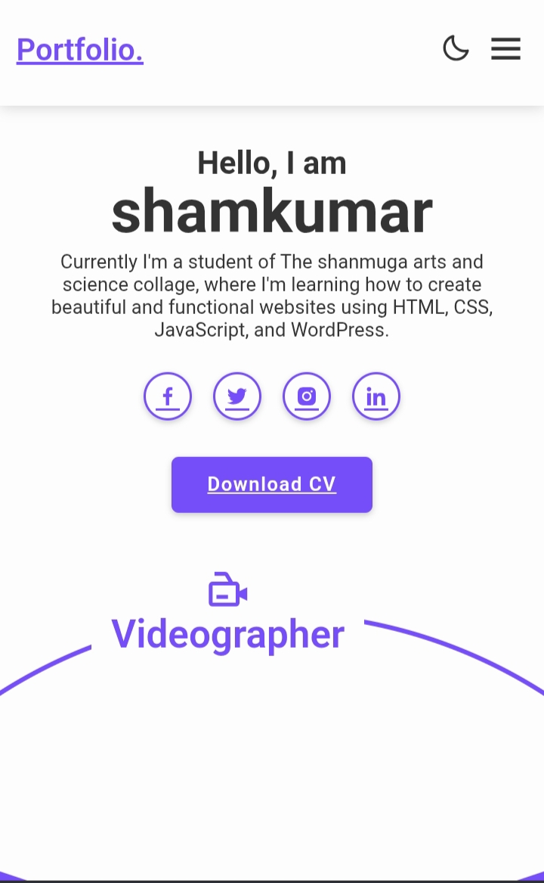
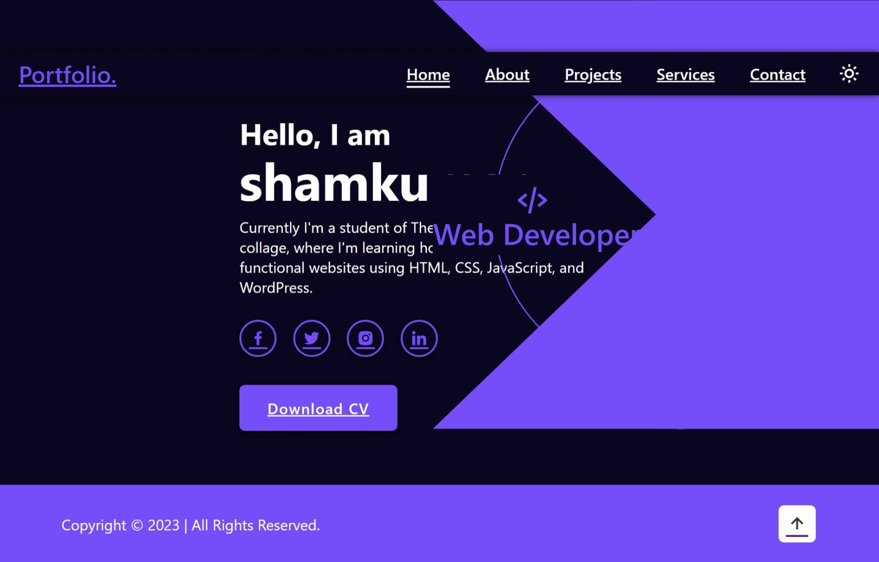

RESULTS AND SCREENSHOTS OF HOME SECTION
3/21/2024 Annual Review
10

Slide 11
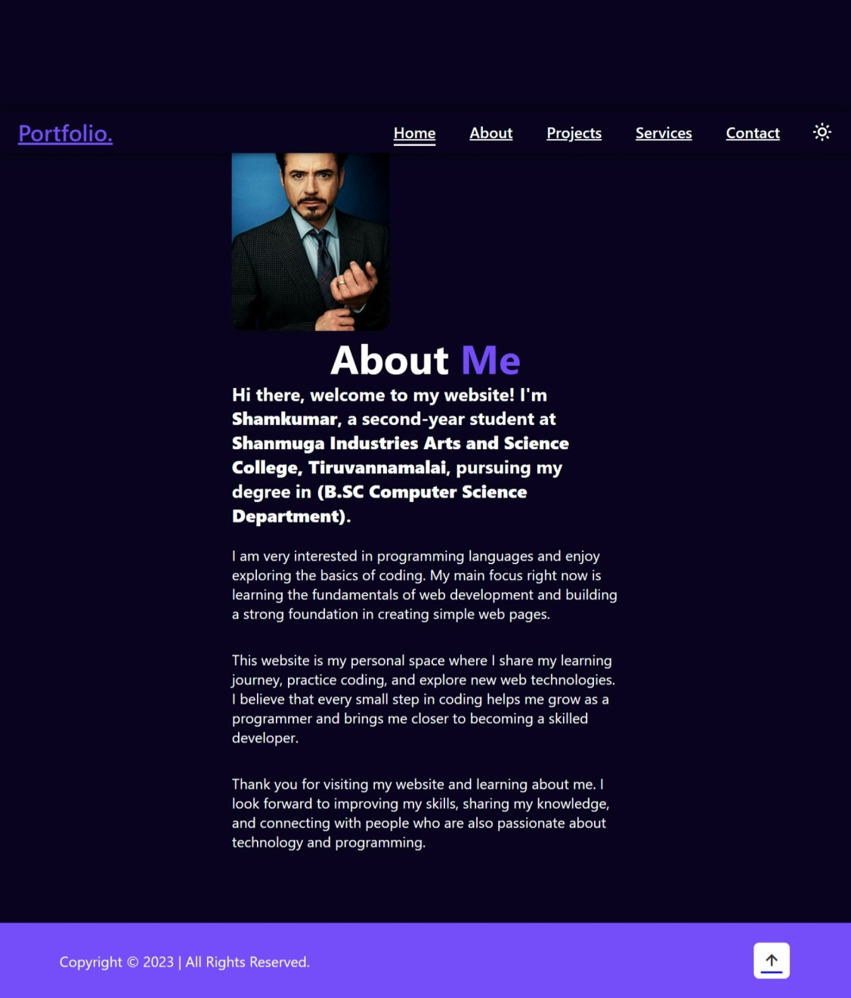
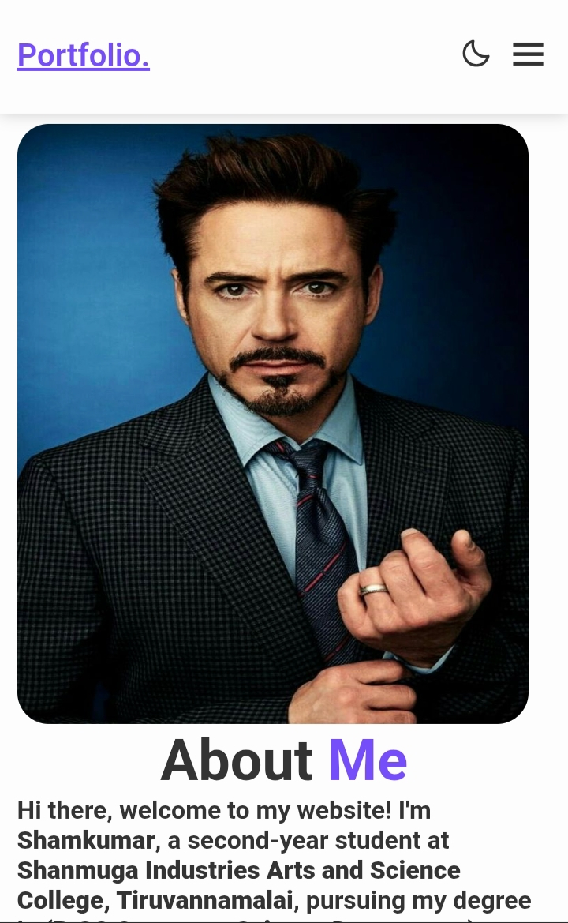
RESULTS AND SCREENSHOTS OF ABOUT SECTION

Slide 12
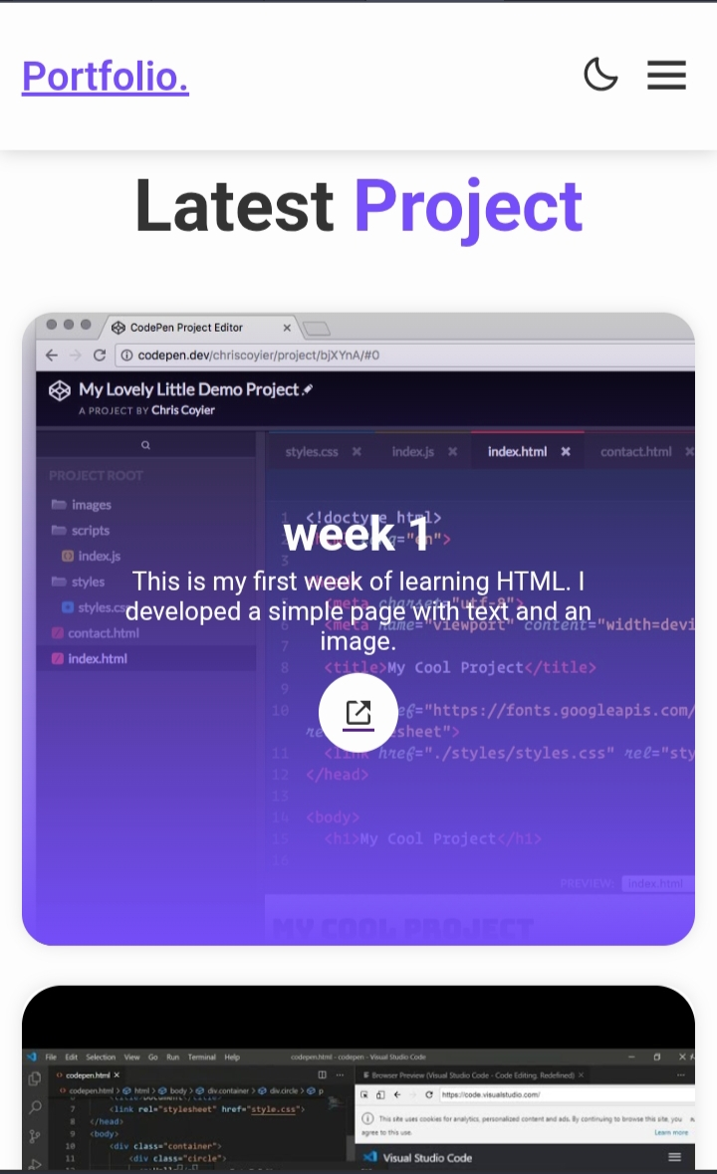
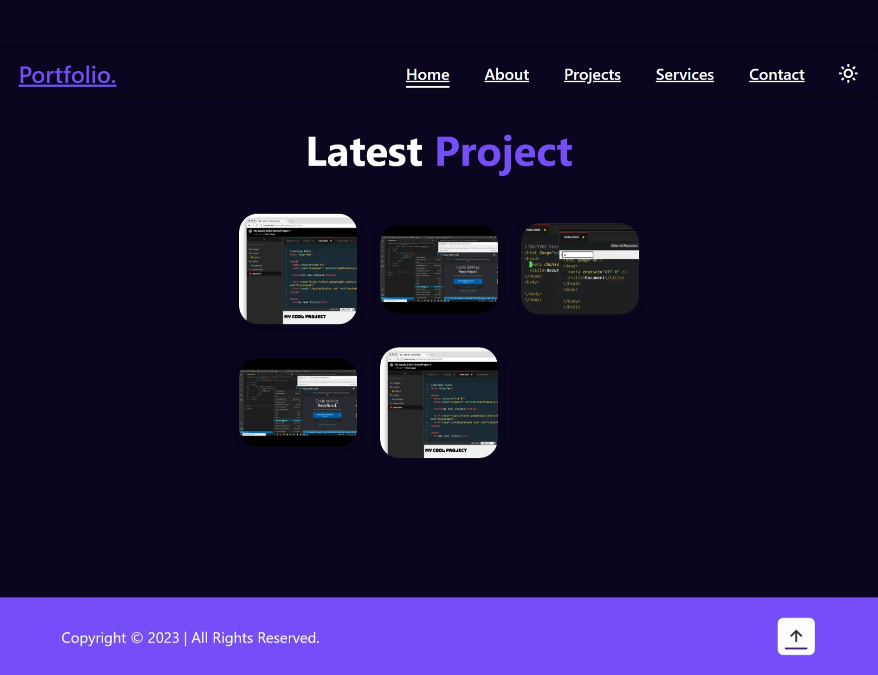
RESULTS AND SCREENSHOTS OF PROJECT SECTION

Slide 13
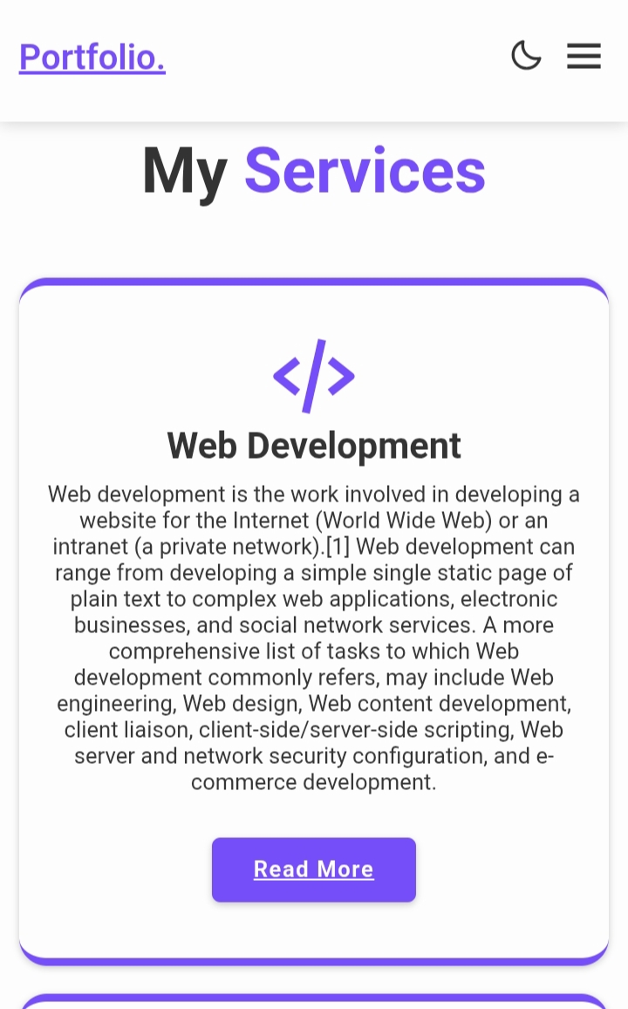
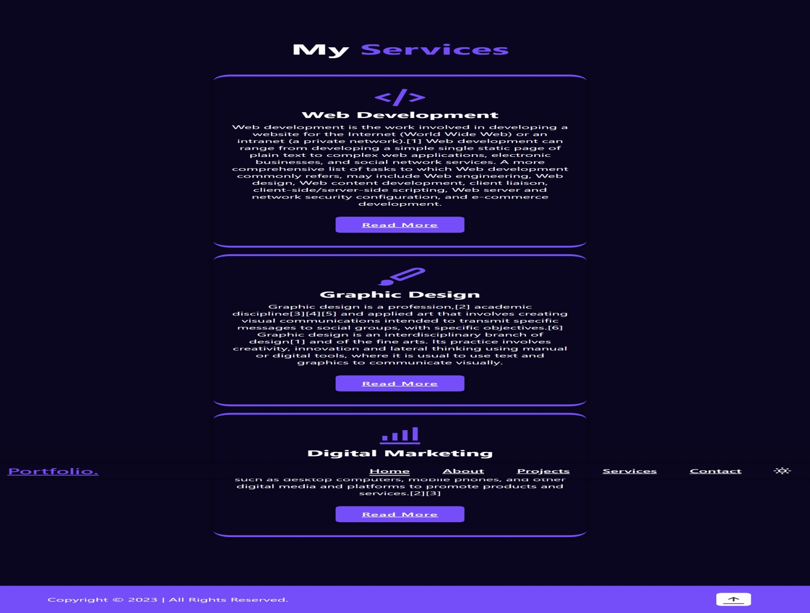
RESULTS AND SCREENSHOTS OF SERVIES SECTION

Slide 14
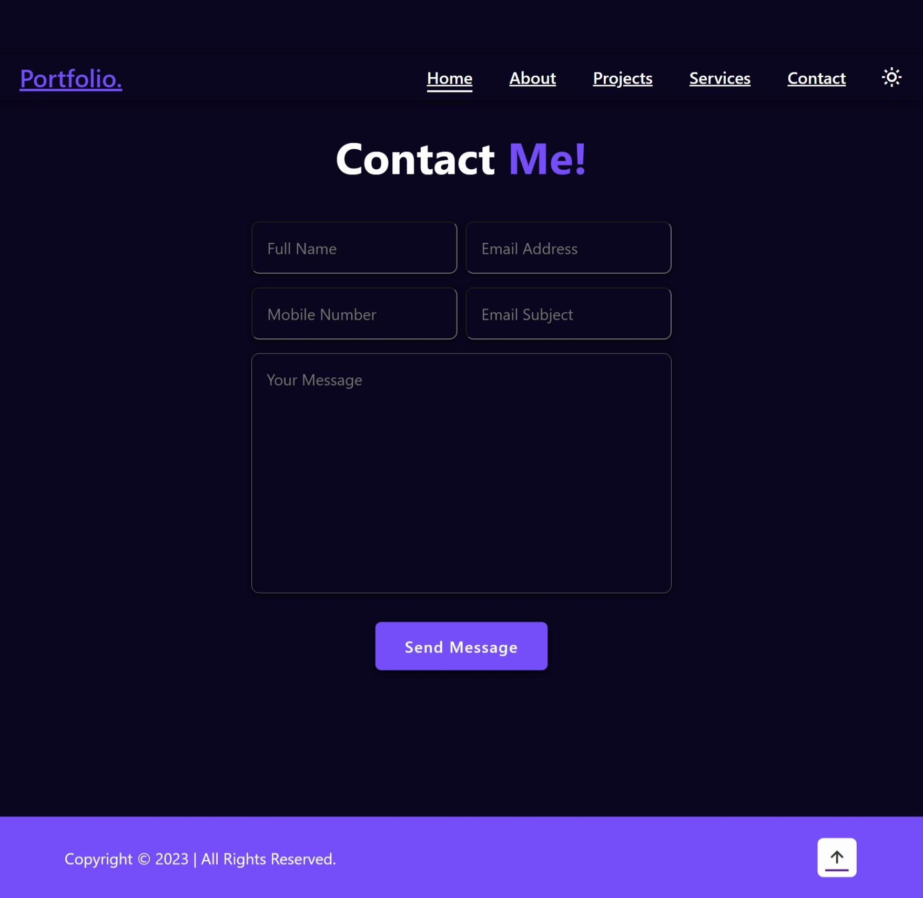
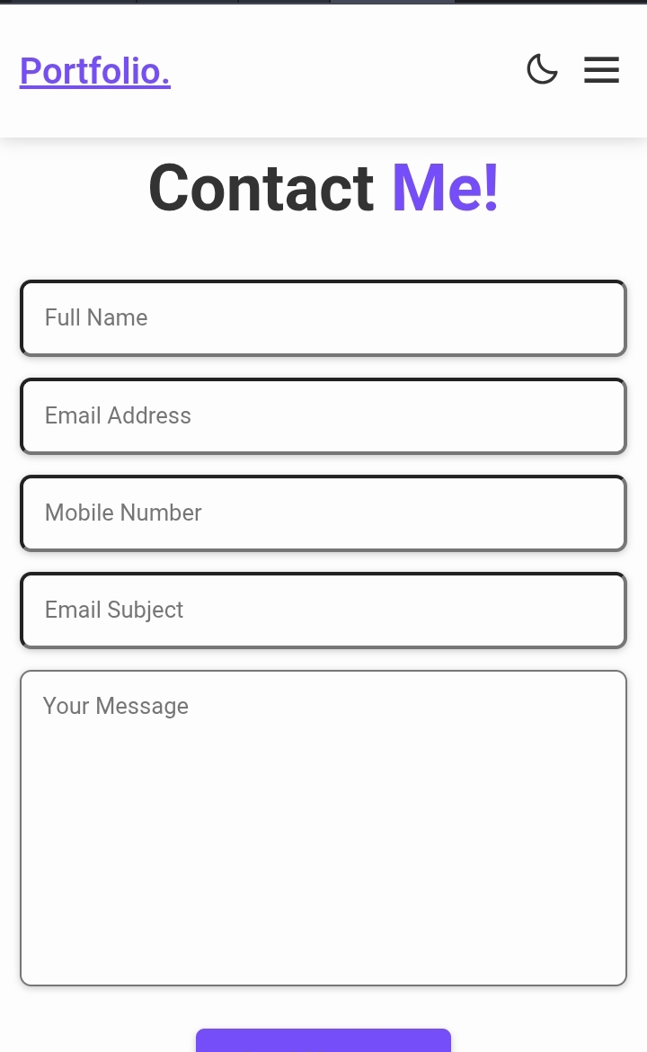
RESULTS AND SCREENSHOTS OF CONTACT SECTION

Slide 15
CONCLUSION
This portfolio project is a good way to show skills, learning, and personal details in one place. It looks modern, works on all devices, and is easy to use. The weekly projects show step-by-step progress, which makes it useful for teachers, friends, or employers. It is not only a personal website but also a learning project that proves the use of HTML, CSS, and JavaScript. In the future, it can be improved by adding more projects, a resume, or better features.
15

